Slide 1

Sextupole calibrations via measurements of off-energy orbit response matrix and high order dispersion
Nicola Carmignani

Slide 2
Outline
Some preliminary definitions
Motivation
Road map
Simulations
Measurements

Slide 3
Preliminary definitions
Chromatic functions:
These functions are linear with sextupole strengths.

Slide 4
Outline
Some preliminary definitions
Motivation
Road map
Simulations
Measurements

Slide 5
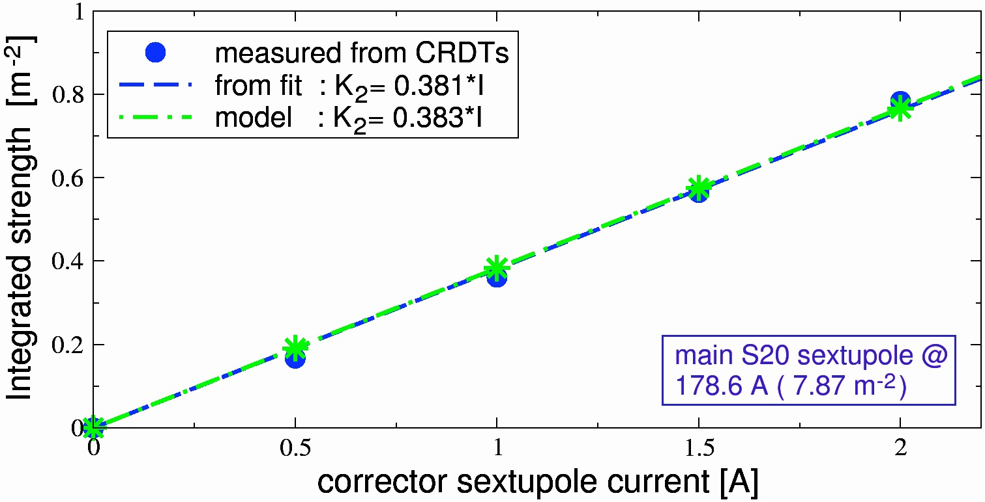
Motivation: sextupole calibration
There are different beam-based methods to calibrate the sextupoles, such as:
measurements of Resonance Driving Terms via turn-by-turn BPM data (PRSTAB 17, 074001, 2014)
This method requires optics with low chromaticity and detuning with amplitude
tune response with bump on sextupoles (PRSTAB, 11, 094001, 2008)
betatron phase advance response with bump on sextupoles (IPAC 17, MOPIK124)
others
    these methods may suffer from degeneracy issues (several sextupoles within an orbit bump).

Slide 6
Motivation: sextupole error model
    We would like to extend the weekly measurements and corrections of linear optics and coupling via orbit response matrix (ORM) to sextupole magnets and first-order nonlinear optics.
    The idea is to measure and fit the off-energy ORM and the 2nd order dispersion to infer and correct the chromatic functions.
Caveat of the off-energy analysis: it is effective only for chromatic sextupoles.
OK for ESRF upgrade like lattices, where all sextupoles are in the dispersion bump.

Slide 7
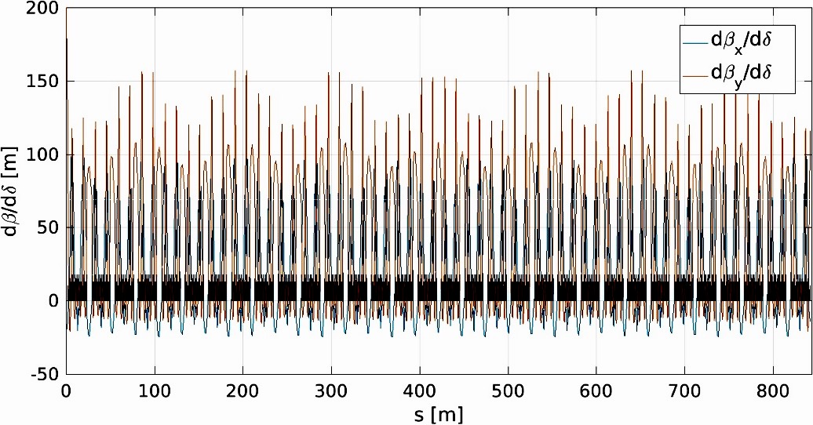
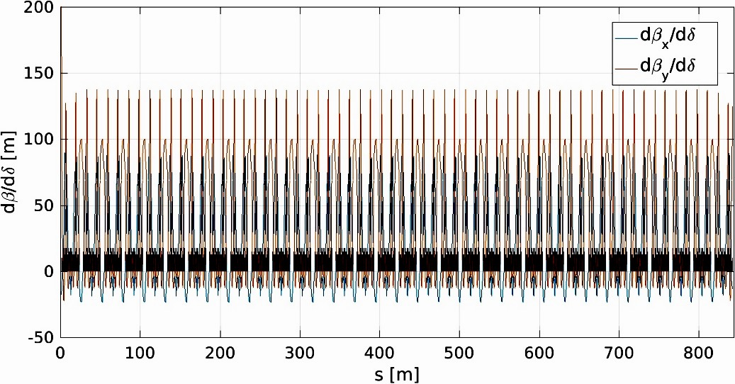
Motivation: Touschek lifetime
The injection cells of the ESRF upgrade produce a beating of the chromatic functions and
If we change the sextupole strengths of the injection cells to have periodic chromatic functions, we recover 10-20% of Touschek lifetime (momentum acceptance increases).

Slide 8
Outline
Some preliminary definitions
Motivation
Road map
Simulations
Measurements

Slide 9
roadmap
    Goal: we would like to extend the weekly measurements and corrections of linear optics and coupling via orbit response matrix (ORM) to sextupole magnets and first-order nonlinear optics.
Get the chromatic functions from the fit of the off-energy Orbit Response Matrix (ORM).
Use the chromatic functions to calibrate a sextupole corrector.
Fit directly the off-energy ORM with sextupoles.
Find a sextupole error model.
Compute the best sextupole correction.
✓done
✓done
in progress
to be done
independent sextupole power supplies needed

Slide 10
Outline
Some preliminary definitions
Motivation
Road map
Simulations
Measurements

Slide 11
Simulations
We want to measure ORM using a frequency shift large enough to observe a measurable variation of the β functions but small enough to remain in the linear regime. With simulations we seek the best energy deviation.
Simulation and fit of the off-energy ORM for several different energy deviations
Compute the chromatic functions from the effective models
Repeat after varying the strength of some sextupole correctors
Extract the sextupole strengths from the difference between the chromatic functions
Chose the best energy deviation that retrieve the sextupole values

Slide 12
Simulations
We want to measure ORM using a frequency shift large enough to observe a measurable variation of the β functions but small enough to remain in the linear regime. With simulations we seek the best energy deviation.
Simulation and fit of the off-energy ORM for several different energy deviations
Compute the chromatic functions from the effective models
Repeat after varying the strength of some sextupole correctors
Extract the sextupole strengths from the difference between the chromatic functions
Chose the best energy deviation that retrieve the sextupole values
δ = +1%
δ = -1%

Slide 13
Simulations
We want to measure ORM using a frequency shift large enough to observe a measurable variation of the β functions but small enough to remain in the linear regime. With simulations we seek the best energy deviation.
Simulation and fit of the off-energy ORM for several different energy deviations
Compute the chromatic functions from the effective models
Repeat after varying the strength of some sextupole correctors
Extract the sextupole strengths from the difference between the chromatic functions
Chose the best energy deviation that retrieve the sextupole values

Slide 14
Simulations
We want to measure ORM using a frequency shift large enough to observe a measurable variation of the β functions but small enough to remain in the linear regime. With simulations we seek the best energy deviation.
Simulation and fit of the off-energy ORM for several different energy deviations
Compute the chromatic functions from the effective models
Repeat after varying the strength of some sextupole correctors
Extract the sextupole strengths from the difference between the chromatic functions
Chose the best energy deviation that retrieve the sextupole values

Slide 15
Simulations
We want to measure ORM using a frequency shift large enough to observe a measurable variation of the β functions but small enough to remain in the linear regime. With simulations we seek the best energy deviation.
Simulation and fit of the off-energy ORM for several different energy deviations
Compute the chromatic functions from the effective models
Repeat after varying the strength of some sextupole correctors
Extract the sextupole strengths from the difference between the chromatic functions
Chose the best energy deviation that retrieve the sextupole values

Slide 16
Simulations
We derive the chromatic functions for several energy deviations.

Slide 17
Simulations
For each energy deviation, we extract the sextupole correctors values and we compare to the ones of the model.

Slide 18
Outline
Some preliminary definitions
Motivation
Road map
Simulations
Measurements

Slide 19
Measurements: derivative of beta functions
We take off-energy ORM at +- 100Hz (delta=0.16%).
The agreement between measurement and AT simulation is much better in vertical than in horizontal.

Slide 20
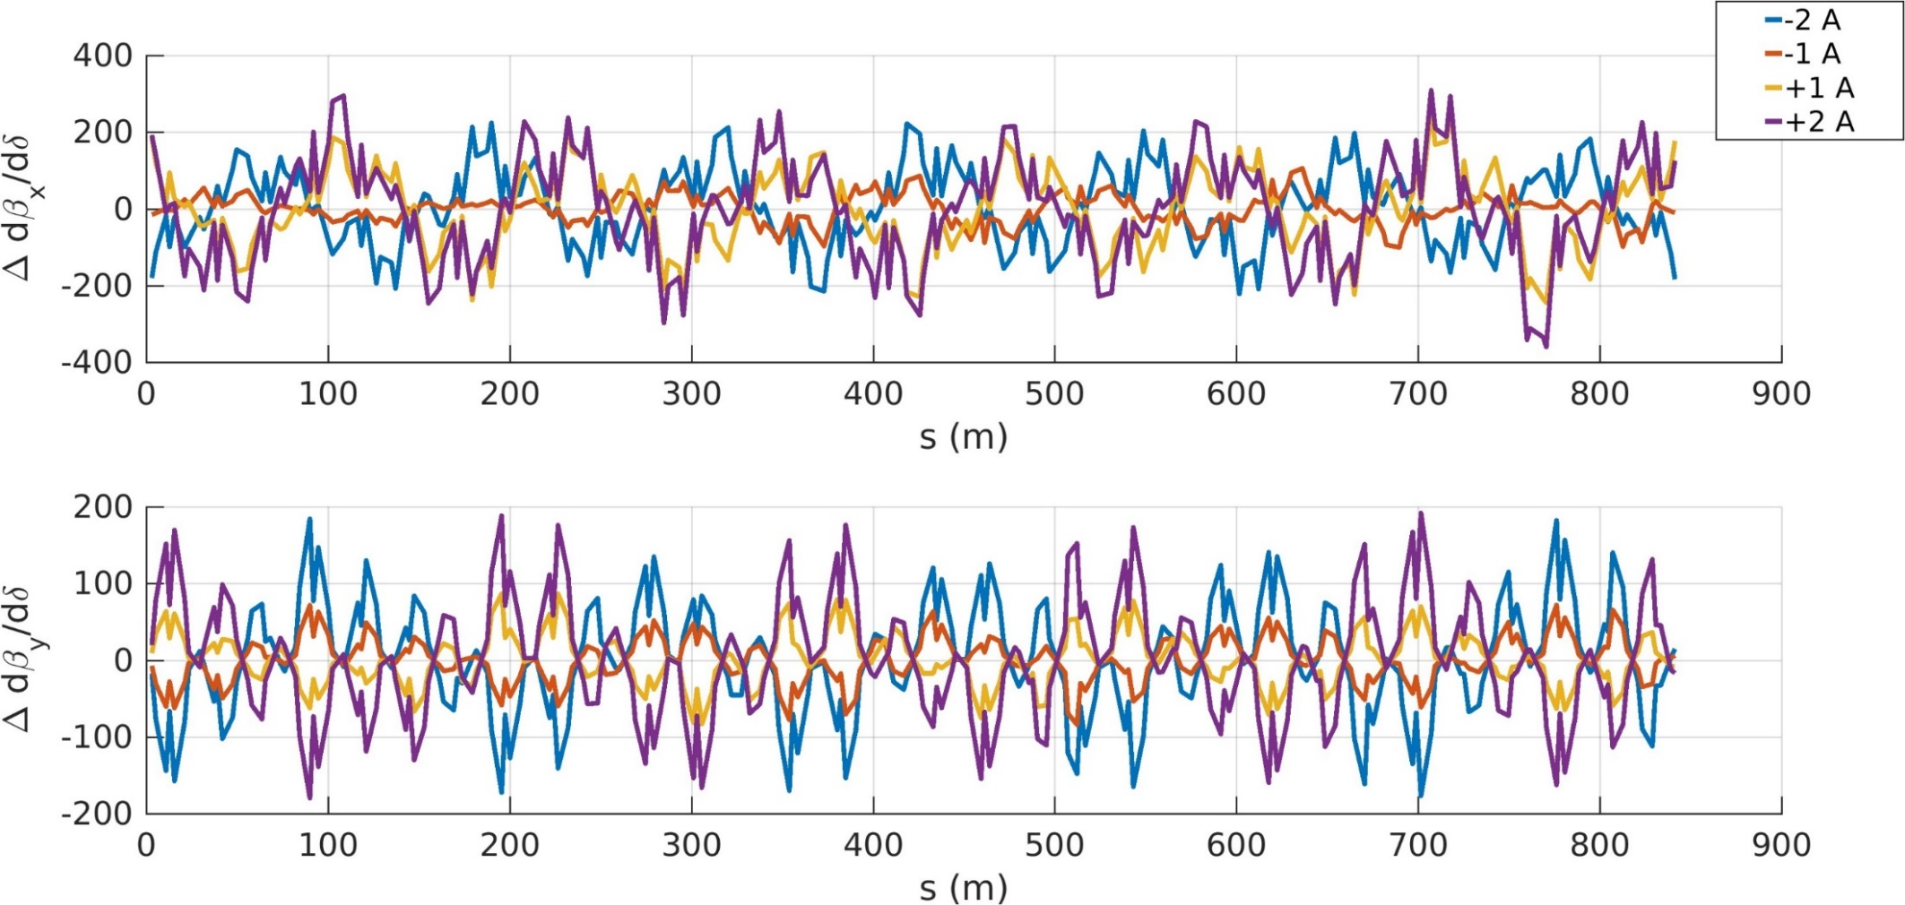
Measurements: derivative of beta functions
We take off-energy ORM for 4 currents of a single sextupole corrector in dispersive region.

Slide 21
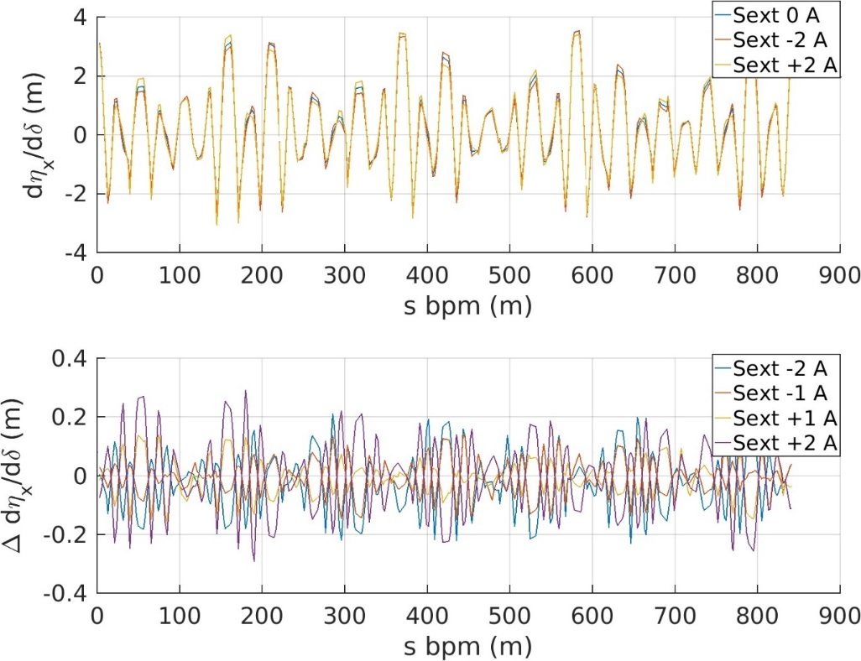
Measurements: Second order dispersion
We measure the horizontal closed orbit at all BPMs for different RF frequencies from -400 Hz to 400 Hz in 10 Hz steps and we fit a third order polynomial at each BPM.
large dispersion BPM
low dispersion BPM

Slide 22
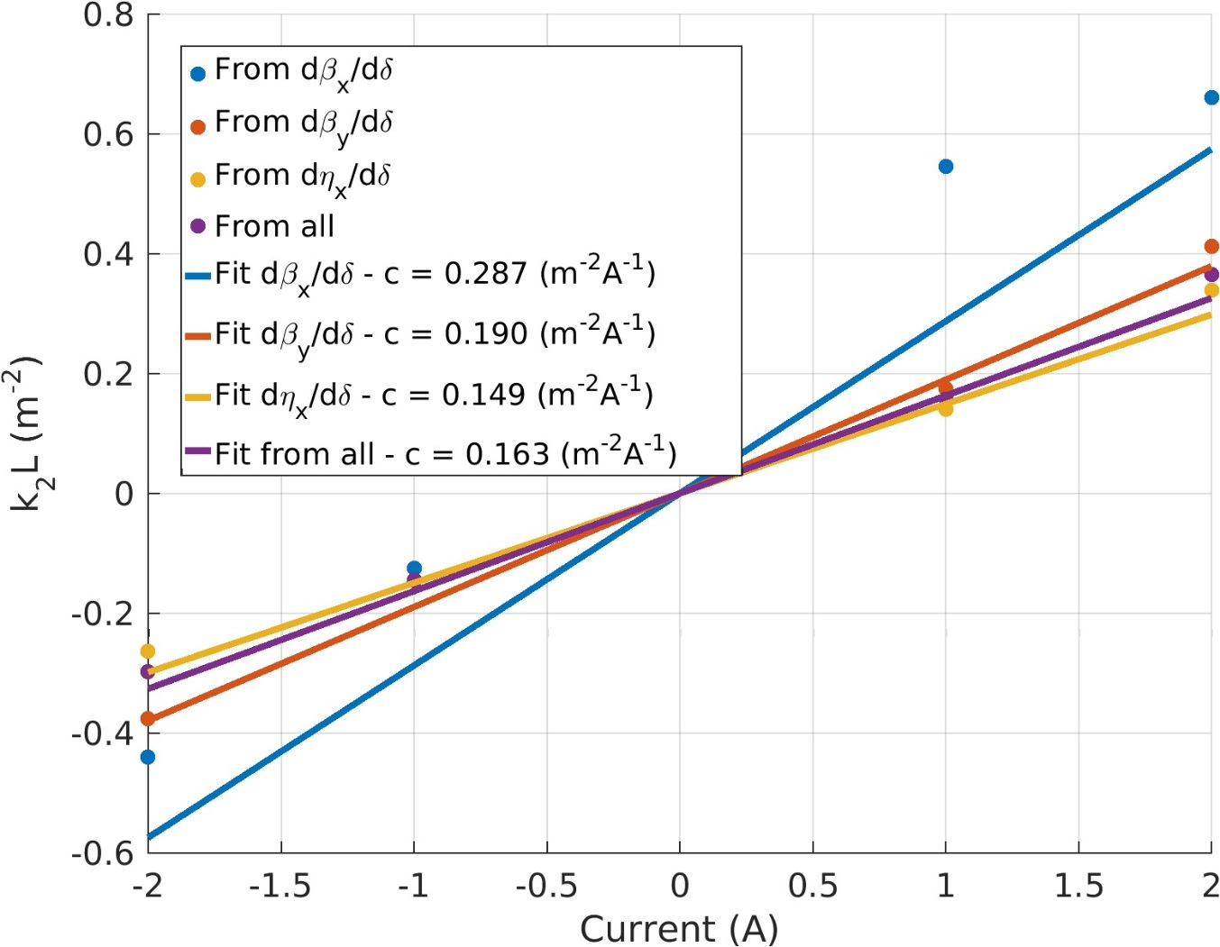
Measurements: Calibration of a sextupole corrector
residuals dβ_{x}/dδ: 0.073
residuals dβ_{y}/dδ: 0.027
residuals dη_{x}/dδ: 0.024
residuals all: 0.019
The calibration factor from magnetic measurements is 0.1569 m⁻² A⁻¹

Slide 23
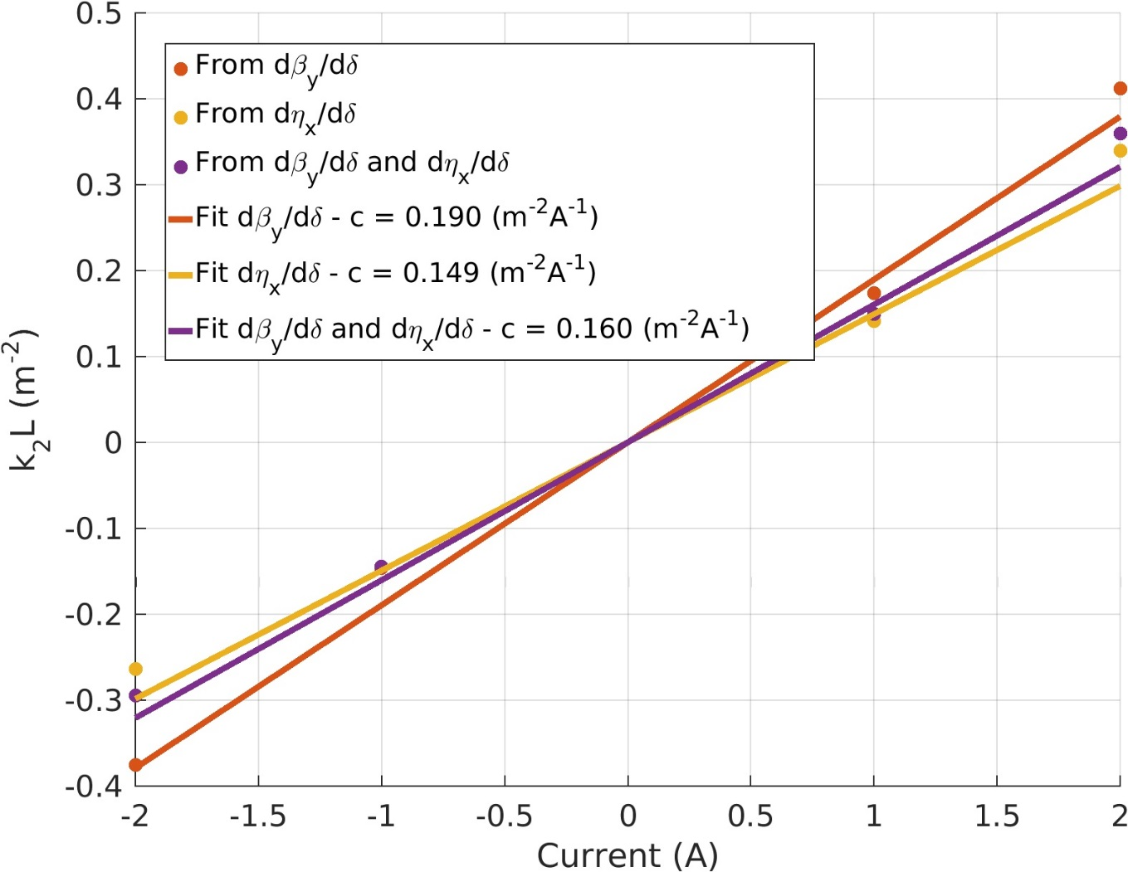
Measurements: Calibration of a sextupole corrector
residuals dβ_{y}/dδ: 0.027
residuals dη_{x}/dδ: 0.024
residuals dβ_{y}/dδ and dη_{x}/dδ: 0.019
The calibration factor from magnetic measurements is 0.1569 m⁻² A⁻¹

Slide 24
Momentum compaction factor from undulator radiation
δ is not an observable. It is controlled by the RF frequency via the momentum compaction factor (α).
Δf_{RF}/f = - α δ
Any deviation of α from the model is introducing a scaling to the chromatic functions and hence to the fitted sextupole strengths. So we want to measure it.
 | α value (10⁻⁴)
Ideal model | 1.7795
Model with errors | 1.8316
ID 20 | 1.76 ±0.14
ID 21 | 1.87 ± 0.11

Slide 25
Momentum compaction factor from hard x-rays camera
δ is not an observable. It is controlled by the RF frequency via the momentum compaction factor (α).
Δf_{RF}/f = - α δ
Any deviation of α from the model is introducing a scaling to the chromatic functions and hence to the fitted sextupole strengths. So we want to measure it.
 | α value (10⁻⁴)
Ideal model | 1.7795
Model with errors | 1.8316
ID 20 | 1.76 ±0.14
ID 21 | 1.87 ± 0.11
hard x-ray camera | 1.760 ± 0.003 (*)
(*) preliminary result

Slide 26
conclusion
The analysis of off-energy Orbit Response Matrix can be used to calibrate sextupole magnets and, possibly, to infer and correct sextupole errors in the ESRF-EBS storage ring.
Chromatic functions are used as observable because their correction improves Touschek lifetime (according to simulations).
As a proof of principle, the calibration of a sextupole corrector has been carried out from this analysis.
The measured second-order dispersion and are in better agreement with the theoretical values than .
Three independent measurements of the momentum compaction have been carried out for a correct conversion Δf_{RF}/f_{RF} -> δ.
A full sextupole error model and its correction are the ultimate goal of the study.

Slide 27

Many thanks for your attention

